Slide 1
HOSTEL ROOM ALLOCATION SYSTEM
Project Review Presentation
Batch – 11 CSE 2-2
Guided by: Mrs. B. Sangeetha

Slide 2
Abstract
Managing hostel room allotment manually can be time-consuming and stressful. Our system automates the allocation process, ensuring fairness and efficiency. It allows students to register, view available rooms, and receive allocations automatically or manually by the admin. The system also supports room change requests and maintenance issue reporting. Administrators get an easy-to-use dashboard for room management, reducing paperwork and improving efficiency.

Slide 3
Existing System
- Manual room allocation process
- Time-consuming and prone to errors
- No centralized database for student-room mapping
- Lack of transparency in room allotment
- Difficulty in tracking vacant rooms and requests
-Difficulty in managing large volumes of student data

Slide 4
Proposed System
- Automated hostel room allocation system
- Students can register and select room preferences
- Admin can allocate rooms manually or automatically
- Features include waitlisting, room change requests, and maintenance reports
- Dashboard for hostel administrators to manage occupancy.
-Automated notifications like allocation ,confrmation ,reminders.
-Enable easy updates,and room management by hostel administration.
-Streamline the Room booking process.
-Fair Allocation based on avaiability and student preferences

Slide 5
Architecture Design
- The system follows a client-server architecture
- Frontend: React.js (for user-friendly interface)
Student Portal:
Login/Registration: For student authentication and profile creation.
Preferences Form: Allows students to input their room preferences, including roommate, room type, etc.
Room Allocation Notification: Displays the allocated room after the process.
Admin Portal:
Admin Login: For hostel management to review applications.
Room Management: Admins can manage room assignments, overrides, or manual allocations.
Allocation Dashboard: Real-time updates for admins to monitor the room allocation process.

Slide 6
- Backend: Node.js/Python (handles business logic)-
Room Allocation Algorithm:
Manages the allocation process based on student preferences, eligibility, and room availability.
Uses rules and priorities (e.g., seniority, special needs, and requests) to assign rooms.
API Layer:
Exposes RESTful APIs for communication between the frontend and backend.
APIs handle operations such as:
Fetching available rooms.
Submitting student preferences.
Allocating rooms based on the algorithm.
Sending notifications to students and admins.

Slide 7
Database: MySQL/PostgreSQL (stores room and student data)
Student Database: Stores student details (name, ID, preferences, eligibility).
Room Database: Stores room information (room number, type, occupancy status).
Allocation Database: Tracks room allocation status and logs.
- Authentication: Email Login, Admission Number
- Hosting: Firebase/DigitalOcean for cloud deployment

Slide 8
Key Features
- Student Interface:
- Room preference selection (e.g., single, double, floor preference)
View room availability and booking status
-Apply for a room and view allocation status
Admin Interface:
Manage room availability and student requests
Generate reports on room occupancy.
-Ability to modify or override room allocation in case of issues.

Slide 9
Algorithm Specifications
1. **First-Come, First-Serve (FCFS):** First registered student gets a room.
2. **Priority-Based Allocation:** Based on seniority, merit, or special needs.
3. **Randomized Allocation:** Ensures fairness but may cause dissatisfaction.
4. **Preference-Based Matching:** Uses Stable Matching Algorithm.
5. **Graph-Based Allocation:** Bipartite matching for optimal assignment.
6. **Waitlist & Reallocation:** Automatically reassigns rooms when vacancies arise.

Slide 10
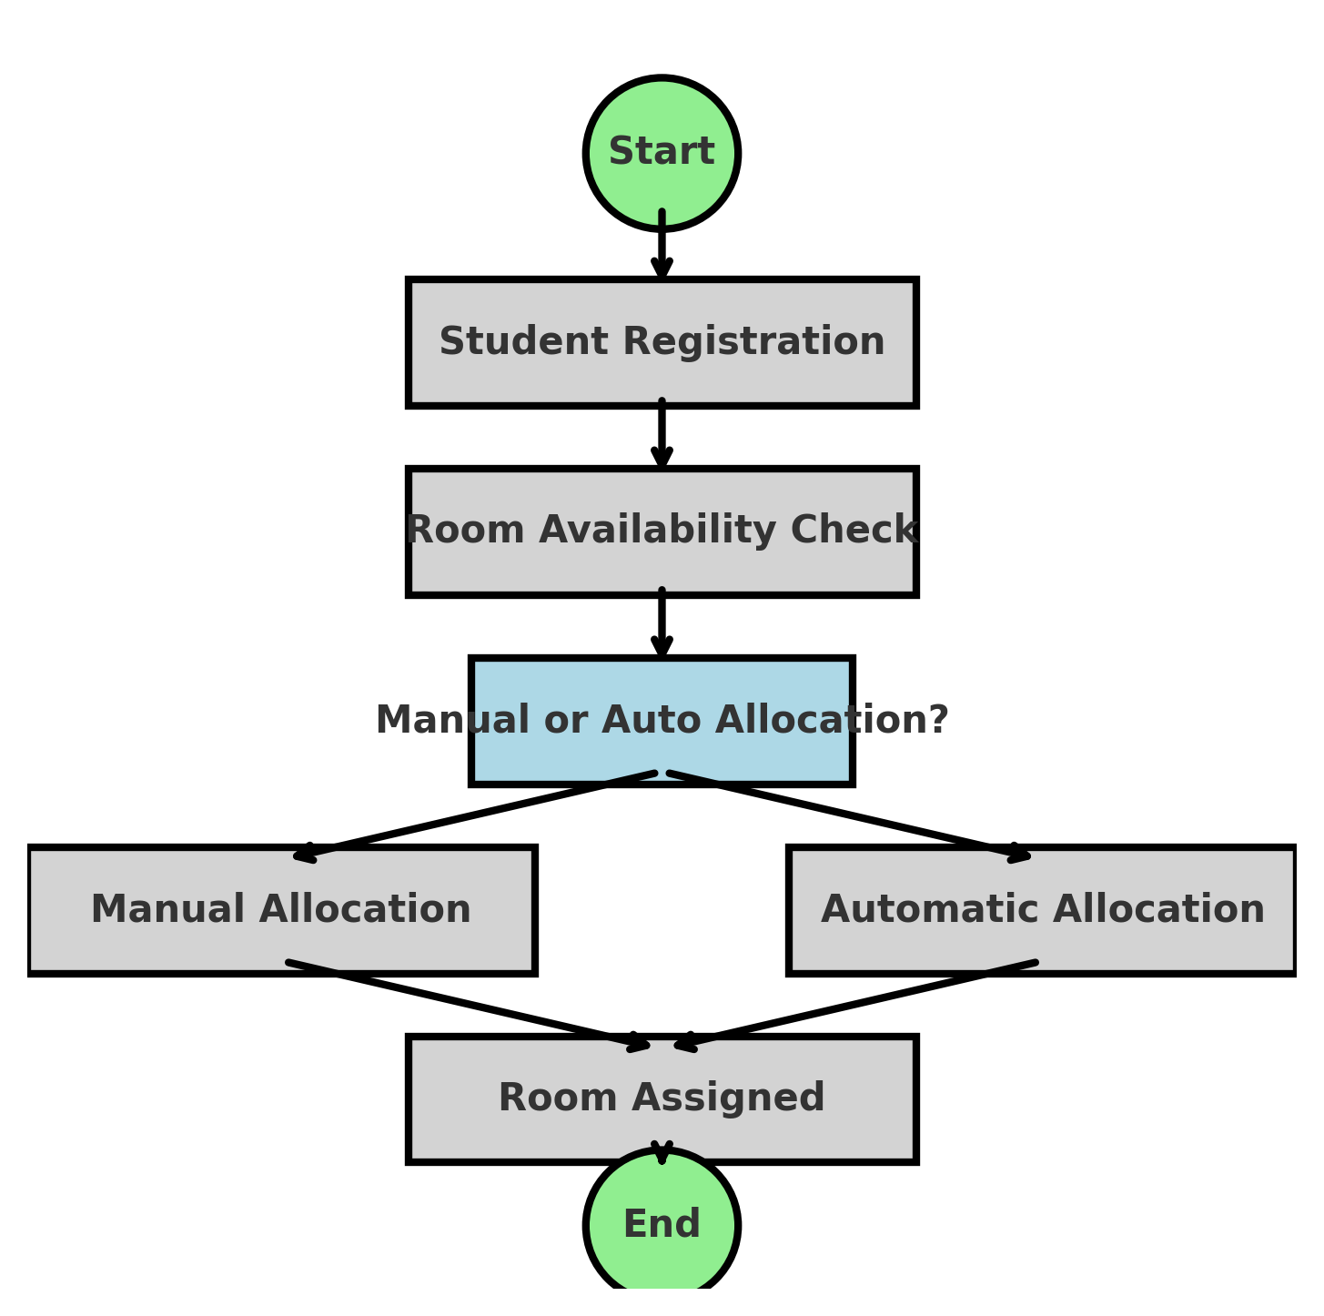
Architecture Design - Flowchart

Slide 11
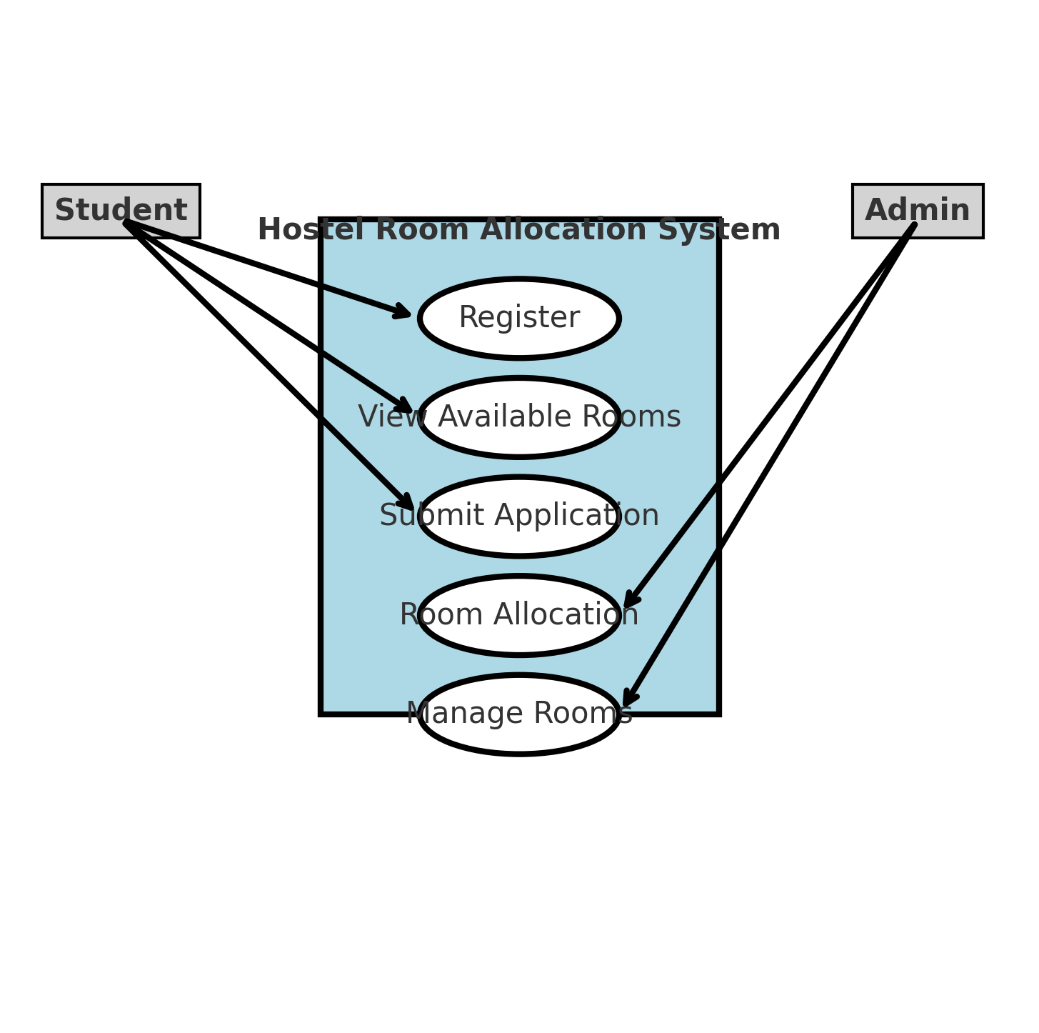
Use Case Diagram

Slide 12
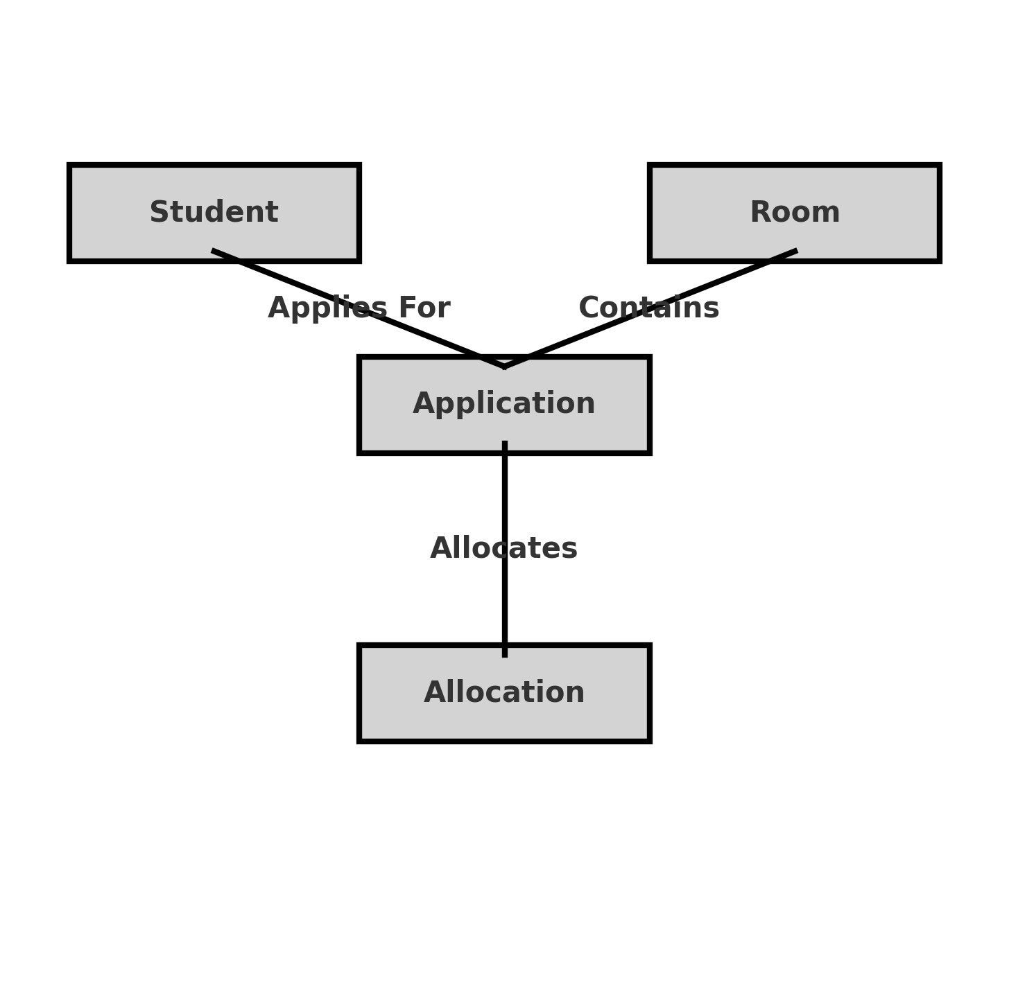
Entity-Relationship Diagram

Slide 13
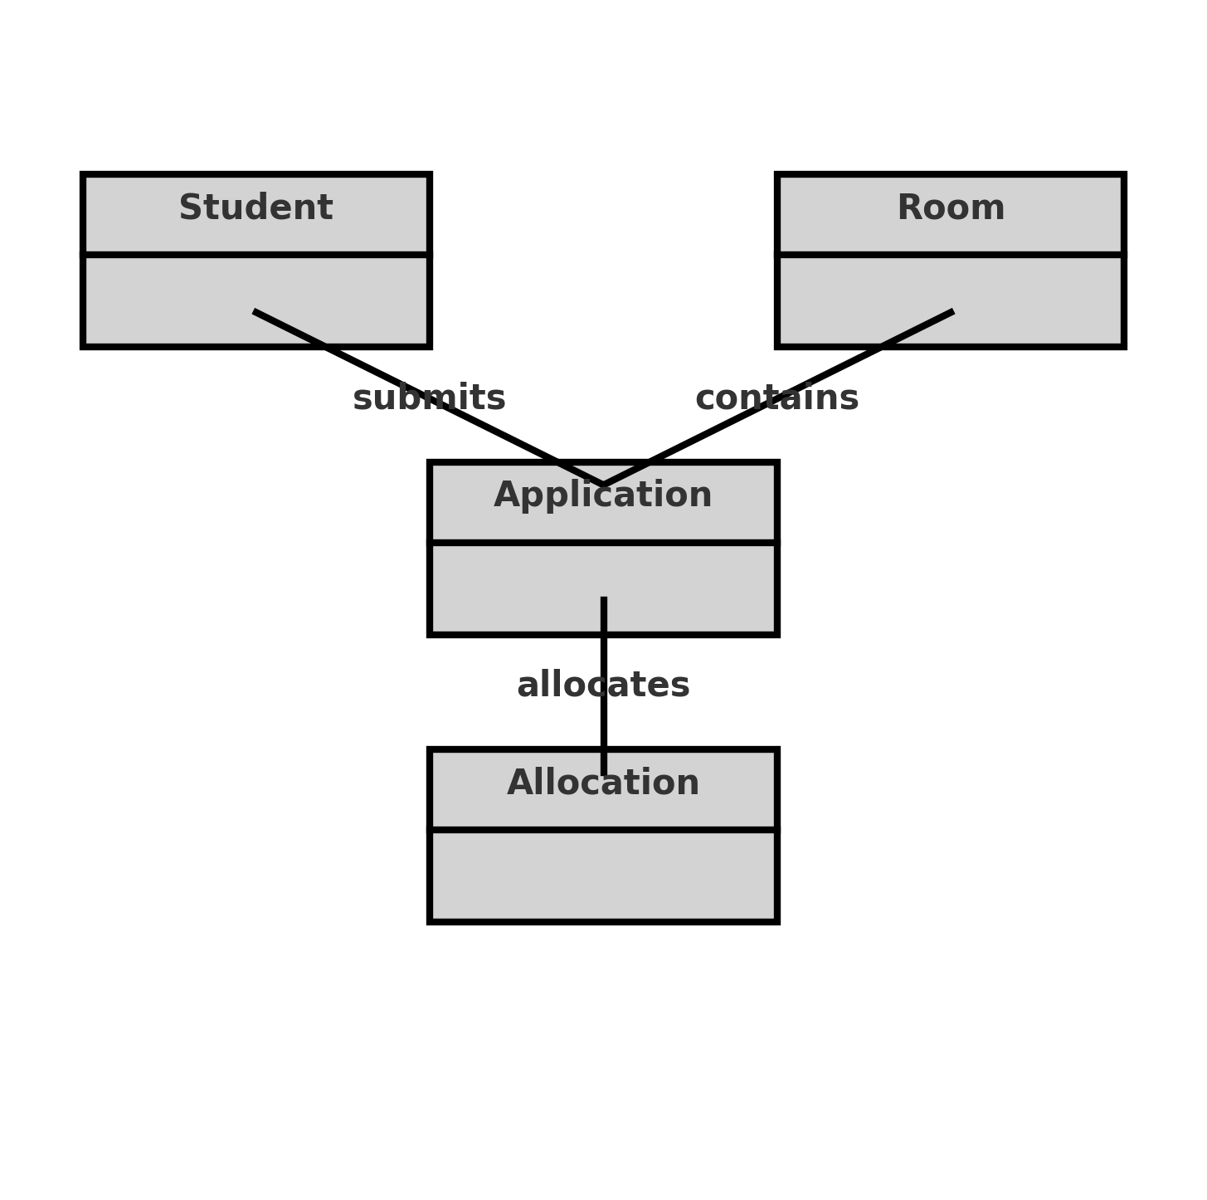
Class Diagram

